Slide 1
UNIT 4
PROGRAMMING IN PYTHON

Slide 2
What is Network Programming in Python?
Python Network Programming is about using Python as a programming language to handle computer networking needful. For representatives, if we want to make and run a transplanted web waitperson or automatically download some ranges from a URL with a pattern.
Python plays an essential business in network programming. The standard library of Python has full support for network protocols, ciphering, and decoding of data and other networking conceptions, and it’s simpler to write network programs in Python than that of C.

Slide 3
Python Network Programming is about using python as a programming language to handle computer networking requirements. For example, if we want to create and run a local web server or automatically download some files from a URL with a pattern.
Network Programming Introduction
Socket programming
Sockets are the links through which the client and servers communicate with each other. For example when a browser is opened a socket is automatically created to connect with the server. Python has a socket module which an be used to implement various socket functionalities like binding an address or starting a listener port. Socket programming is fundamental to computer networking and python handles it well.

Slide 4
Client programming
The client is the computer which requests for information and waits for the response. Python programs can be written to validate many client-side actions like parsing a URL, sending parameters with the URL while submitting a request, connect to a alternate URL if access to one URL becomes unsuccessful etc. These programs are run in the client programs and handle all the communication needs with the server even without using a browser. For example – you can provide an URL to the python program for downloading a file and it will get done by the program itself without taking help from the browser program.

Slide 5
Building web servers
It is possible to create simple web servers which are good enough to run websites using python as a programming language. Python already has some inbuilt web servers which can be tweaked to achieve some additional functionalities needed.
The SimpleHTTPServer module provides the functionalities of a web server out of the box and you can start running it from the local python installation. In python 3 it is named as http.serverCherryPy and Tornado are examples of webservers written in python which run as good as non python well known web servers like Apache or Ngnix.

Slide 6
Web Scrapping
One of the important reasons python became famous is the its dominance among the languages used for scrapping the web. Its data structure and network access abilities makes it ideal for visiting webpages and download their data automatically. And if there is some API connectivity available for the target website, then python will handle it even more easily through its program structures.

Slide 7
Web Frame works
Web Frame works makes application development easy and fast by offering pre-defined structures and modularity. The developer has to do minimal coding to leverage those existing libraries and customize a little to achieve the goal. Django and Flask are two famous ones which have seen much commercial use even though they are opensource.

Slide 8
Internet Protocol
The Internet Protocol is designed to implement a uniform system of addresses on all of the Internet-connected computers everywhere and to make it possible for packets to travel from one end of the Internet to the other. A program like the web browser should be able to connect to a host anywhere without ever knowing which maze of network devices each packet is traversing on its journey. There are various categories of internet protocols. These protocols are created to serve the needs of different types of data communication between different computers in the internet.

Slide 9
Python has several modules to handle each of these communication scenarios.
Protocol | Python Module Name | Description
HTTP | urllib.request | Opening the HTTP URL
HTTP | urllib.response | Create a reponse object for a url request
HTTP | urllib.parse | To break Uniform Resource Locator (URL) strings up in components like (addressing scheme, network location, path etc.),
HTTP | urllib.robotparser | It finds out whether or not a particular user agent can fetch a URL on the Web site that published the robots.txt file.

Slide 10
FTP | ftplib | implements the client side of the FTP protocol. You can use this to write Python programs that perform a variety of automated FTP jobs, such as mirroring other FTP servers.
POP | poplib | This module defines a class, POP3, which encapsulates a connection to a POP3 server to read messages from a email server
IMAP | imaplib | This module defines three classes, IMAP4, IMAP4_SSL and IMAP4_stream, which encapsulate a connection to an IMAP4 server to read emails.
SMTP | smtplib | The smtplib module defines an SMTP client session object that can be used to send mail to any Internet machine with an SMTP listner deamon.

Slide 11
Python provides two levels of access to network programming. These are –
Low-Level Access: At the low level, you can access the basic socket support of the operating system. You can implement client and server for both connection-oriented and connectionless protocols.
High-Level Access: At the high level allows to implement protocols like HTTP, FTP, etc.

Slide 12
What are Sockets?
Consider a bidirectional communication channel, the sockets are the endpoints of this communication channel. These sockets (endpoints) can communicate within a process, between processes on the same machine, or between the processes on the different machines. Sockets use different protocols for determining the connection type for port-to-port communication between clients and servers.
Sockets and the socket API are used to send messages across a network. They provide a form of inter-process communication (IPC). The network can be a logical, local network to the computer, or one that’s physically connected to an external network, with its own connections to other networks. The obvious example is the Internet, which you connect to via your ISP.

Slide 13
Sockets Vocabulary
Sockets have their own set of vocabulary, let’s have a look at them –
Term | Description
Domain | The set of protocols used for transport mechanisms like AF_INET, PF_INET, etc.
Type | Type of communication between sockets
Protocol | Identifies the type of protocol used within domain and type. Typically it is zero
Port | The server listens for clients calling on one or more ports. it can be a string containing a port number, a name of the service, or a Fixnum port
Hostname | Identifies a network interface. It can be a a string containing hostname, IPv6 address, or a double-quad address. an integer a zero-length string a string “<brodcast>”

Slide 14
Socket Programming
Socket programming is a way of connecting two nodes on a network to communicate with each other. One socket(node) listens on a particular port at an IP, while the other socket reaches out to the other to form a connection. The server forms the listener socket while the client reaches out to the server. They are the real backbones behind web browsing. In simpler terms, there is a server and a client. We can use the socket module for socket programming. For this, we have to include the socket module –
import socket
to create a socket we have to use the socket.socket() method.
Syntax:
socket.socket(socket_family, socket_type, protocol=0)
Where,
socket_family: Either AF_UNIX or AF_INET
socket_type: Either SOCK_STREAM or SOCK_DGRAM.
protocol: Usually left out, defaulting to 0.

Slide 15
Example:
import socket s = socket.socket(socket.AF_INET, socket.SOCK_STREAM) print(s)
Output :
<socket.socket fd=74, family=AddressFamily.AF_INET, type=SocketKind.SOCK_STREAM, proto=0, laddr=(‘0.0.0.0’, 0)>

Slide 16
The socket module provides various methods for both client and server-side programming. Let’s see each method in detail.
Socket Server Methods
These methods are used on the server-side. Let’s see each method in detail –
Function Name | Description
s.bind() | Binds address to the socket. The address contains the pair of hostname and the port number.
s.listen() | Starts the TCP listener
s.accept() | Passively accepts the TCP client connection and blocks until the connection arrives

Slide 17
Socket Client Methods
This method is used on the client side. Let’s see this method in detail –
Function Name | Description
s.connect() | Actively starts the TCP server connection

Slide 18
Socket General Methods
These are the general methods of the socket module. Let’s see each method in detail.
Function Name | Description
s.send() | Sends the TCP message
s.sendto() | Sends the UDP message
s.recv() | Receives the TCP message
s.recvfrom() | Receives the UDP message
s.close() | Close the socket
socket.ghostname() | Returns the host name

Slide 19
Python Program that Sends And Receives Message from Client
import socket
# take the server name and port name
host = 'local host'
port = 5000
# create a socket at server side
# using TCP / IP protocol
s = socket.socket(socket.AF_INET,
socket.SOCK_STREAM)
# bind the socket with server
# and port number
s.bind(('', port))
# allow maximum 1 connection to
# the socket
s.listen(1)
# wait till a client accept
# connection
c, addr = s.accept()
# display client address
print("CONNECTION FROM:", str(addr))
# send message to the client after
# encoding into binary string
c.send(b"HELLO, How are you ? \
Welcome to Akash hacking World")
msg = "Bye.............."
c.send(msg.encode())
# disconnect the server
c.close()

Slide 20
TCP/IP server program that receive message from server.
import socket
# take the server name and port name
host = 'local host'
port = 5000
# create a socket at client side
# using TCP / IP protocol
s = socket.socket(socket.AF_INET,
socket.SOCK_STREAM)
# connect it to server and port
# number on local computer.
s.connect(('127.0.0.1', port))
# receive message string from
# server, at a time 1024 B
msg = s.recv(1024)
# repeat as long as message
# string are not empty
while msg:
print('Received:' + msg.decode())
msg = s.recv(1024)
# disconnect the client
s.close()
Note: Open In Two Separate DOS Windows And First Execute server, then Execute client.

Slide 21
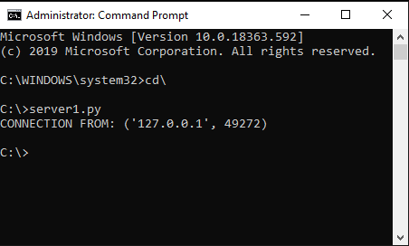
Output of Server:

Slide 22
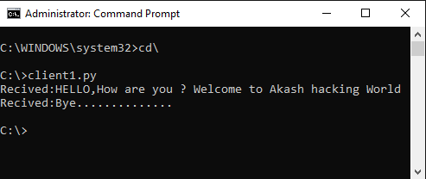
Output of Client:

Slide 23
IP Address
IP Address (Internet Protocol) is a fundamental networking concept that provides address assignation capability in a network. The python module ipaddress is used extensively to validate and categorize IP address to IPV4 and IPV6 type. It can also be used to do comparison of the IP address values as well as IP address arithmetic for manipulating the ip addresses.
Validate the IPV4 Address
The ip_address function validates the IPV4 address. If the range of values is beyond 0 to 255, then it throws an error.
Import ipaddress
print (ipaddress.ip_address(u'192.168.0.255'))
print (ipaddress.ip_address(u'192.168.0.256'))
When we run the above program, we get the following output −
192.168.0.255
ValueError: u'192.168.0.256' does not appear to be an IPv4 or IPv6 address

Slide 24
IPv6 : It is represented by eight groups of four hexadecimal digits separated by colons, where each group represents 16 bits, two octets also known as hextet. The ip_address() function throws an error if the range value exceeds from 0 to FFFF.
# Import module
import ipaddress
# Example of valid IPv6 address
print (ipaddress.ip_address(u'2001:0db8:85a3:2bfe:070d:8a2e:0370:7334'))
# Invalid IPv6 address raises error
print (ipaddress.ip_address(u'2001:0db8:85a3:0ff0:00000:8a2e:0370:7334'))

Slide 25
Operations on IP Address-
Various operations like arithmetic, comparison, type, etc can be performed on the IP addresses with the help of ipaddress module. Some operations are listed below:
Type Check operation: The type() method takes various formats of IP addresses as input and recognizes whether it is IPv4 or IPv6 address, indicating the category of the IP address.

Slide 26
import ipaddress
# IPv4 address
print(type(ipaddress.ip_address(u'175.198.42.211')))
print(type(ipaddress.ip_address(u'5.0.0.1')))
# IPv6 address
print(type(ipaddress.ip_address(u'2001:0db8:85a3:2bfe:070d:8a2e:0370:7334')))
print(type(ipaddress.ip_address(u'0000:f0f0::7b8a:ffff')))
Output :
<class ‘ipaddress.IPv4Address’>
<class ‘ipaddress.IPv4Address’>
<class ‘ipaddress.IPv6Address’>
<class ‘ipaddress.IPv6Address’>

Slide 27
Python program to find the IP Address of the client
## importing socket module
import socket
## getting the hostname by socket.gethostname() method hostname = socket.gethostname()
## getting the IP address using socket.gethostbyname() method ip_address = socket.gethostbyname(hostname)
## printing the hostname and ip_address
print(f"Hostname: {hostname}")
print(f"IP Address: {ip_address}")
Output :
Hostname: STUD-PC
IP Address: 192.168.10.71

Slide 28
What is urllib?
urllib is a Python module that can be used for opening URLs. It defines functions and classes to help in URL actions.
With Python you can also access and retrieve data from the internet like XML, HTML, JSON, etc. You can also use Python to work with this data directly.
How to Open URL using Urllib
Before we run the code to connect to Internet data, we need to import statement for URL library module or “urllib”.

Slide 29
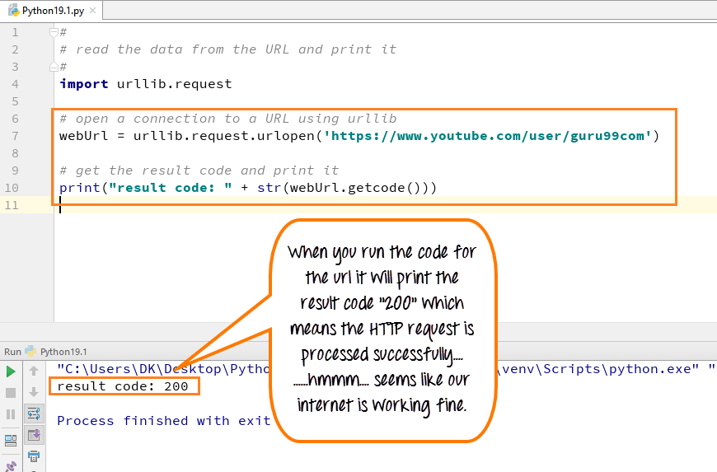

Slide 30
Import urllib
Define your main function
Declare the variable webUrl
Then call the urlopen function on the URL lib library
The URL we are opening is guru99 tutorial on youtube
Next, we going to print the result code
Result code is retrieved by calling the getcode function on the webUrl variable we have created
We going to convert that to a string, so that it can be concatenated with our string “result code”
This will be a regular HTTP code “200”, indicating http request is processed successfully

Slide 31
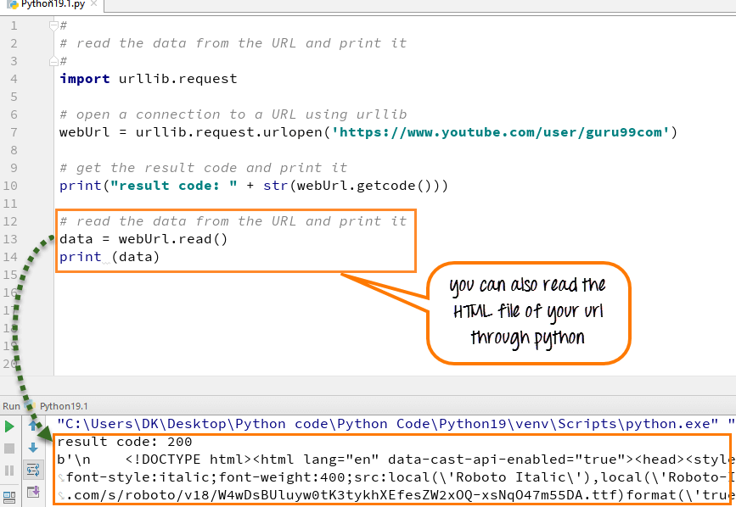
How to get HTML file form URL
You can also read the HTML file by using the “read function” in Python, and when you run the code, the HTML file will appear in the console.

Slide 32
Call the read function on the webURL variable
Read variable allows to read the contents of data files
Read the entire content of the URL into a variable called data
Run the code- It will print the data into HTML format

Slide 33
# # read the data from the URL and print it
# import urllib.request
def main():
# open a connection to a URL using urllib2 webUrl = urllib.request.urlopen("https://www.youtube.com/user/guru99com") #get the result code and print it
print ("result code: " + str(webUrl.getcode()))
# read the data from the URL and print it
data = webUrl.read()
print (data )
if __name__ == "__main__":
main()

Slide 34
Downloading files from web using Python
Requests is a versatile HTTP library in python with various applications. One of its applications is to download a file from web using the file URL.
Download and read webpage line by line
Example
import urllib.request
fid=urllib.request.urlopen('http://www.example.org/')
webpage=fid.read().decode('utf-8')
print(webpage)

Slide 35
How to download an image in Python
Web scraping is a technique to fetch data from websites. While surfing on the web, many websites don’t allow the user to save data for personal use. One way is to manually copy-paste the data, which both tedious and time-consuming. Web Scraping is the automation of the data extraction process from websites.
Import requests
response = requests.get("https://i.imgur.com/ExdKOOz.png")
file = open("sample_image.png", "wb")
file.write(response.content)
file.close()

Slide 36
from bs4 import *
import requests
import os
# CREATE FOLDER
def folder_create(images):
try:
folder_name = input("Enter Folder Name:- ")
# folder creation
os.mkdir(folder_name)
# if folder exists with that name, ask another name
except:
print("Folder Exist with that name!")
folder_create()
# image downloading start
download_images(images, folder_name)

Slide 37
# DOWNLOAD ALL IMAGES FROM THAT URL
def download_images(images, folder_name):
# initial count is zero
count = 0
# print total images found in URL
print(f"Total {len(images)} Image Found!")
# checking if images is not zero
if len(images) != 0:
for i, image in enumerate(images):
# From image tag ,Fetch image Source URL
# 1.data-srcset
# 2.data-src
# 3.data-fallback-src
# 4.src

Slide 38
# Here we will use exception handling
# first we will search for "data-srcset" in img tag
try:
# In image tag ,searching for "data-srcset"
image_link = image["data-srcset“]
# then we will search for "data-src" in img
# tag and so on..
except:
try:
# In image tag ,searching for "data-src"
image_link = image["data-src"]
except:
try:
# In image tag ,searching for "data-fallback-src"
image_link = image["data-fallback-src"]
except:
try:
# In image tag ,searching for "src"
image_link = image["src"]

Slide 39
# if no Source URL found
except:
pass
# After getting Image Source URL
# We will try to get the content of image
try:
r = requests.get(image_link).content
try:
# possibility of decode
r = str(r, 'utf-8')

Slide 40
except UnicodeDecodeError:
# After checking above condition, Image Download start
with open(f"{folder_name}/images{i+1}.jpg", "wb+") as f:
f.write(r)
# counting number of image downloaded
count += 1
except:
pass
# There might be possible, that all
# images not download
# if all images download
if count == len(images):
print("All Images Downloaded!")
# if all images not download
else:
print(f"Total {count} Images Downloaded Out of {len(images)}")

Slide 41
# MAIN FUNCTION START
def main(url):
# content of URL
r = requests.get(url)
# Parse HTML Code
soup = BeautifulSoup(r.text, 'html.parser')
# find all images in URL
images = soup.findAll('img')
# Call folder create function
folder_create(images)
# take url
url = input("Enter URL:- ")
# CALL MAIN FUNCTION
main(url)

Slide 42
Approach
Import module
Get HTML Code
Get list of img tags from HTML Code using findAll method in Beautiful Soup.
images = soup.findAll('img')
Create separate folder for downloading images using mkdir method in os.
os.mkdir(folder_name)Iterate through all images and get the source URL of that image.
After getting the source URL, last step is download the image
Fetch Content of Image
r = requests.get(Source URL).content

Slide 43
Download image using File Handling
# Enter File Name with Extension like jpg, png etc..
with open("File Name","wb+") as f:
f.write(r)

Slide 44
TCP/IP Client and Server
Sockets can be configured to act as a server and listen for incoming messages, or connect to other applications as a client. After both ends of a TCP/IP socket are connected, communication is bi-directional.

Slide 45
Server Program
#!/usr/bin/python3 # This is server.py file
import socket
# create a socket object
serversocket = socket.socket(
socket.AF_INET, socket.SOCK_STREAM)
# get local machine name
host = socket.gethostname()
port = 9999
# bind to the port
serversocket.bind((host, port))
# queue up to 5 requests
serversocket.listen(5)

Slide 46
while True:
# establish a connection
clientsocket,addr = serversocket.accept()
print("Got a connection from %s" % str(addr))
msg = 'Thank you for connecting'+ "\r\n"
clientsocket.send(msg.encode('ascii'))
clientsocket.close()

Slide 47
Client Program
#!/usr/bin/python3 # This is client.py file
import socket
# create a socket object
s = socket.socket(socket.AF_INET, socket.SOCK_STREAM)
# get local machine name
host = socket.gethostname()
port = 9999
# connection to hostname on the port.
s.connect((host, port))
# Receive no more than 1024 bytes
msg = s.recv(1024)
s.close()
print (msg.decode('ascii'))

Slide 48
Now run this server.py in the background and then run the above client.py to see the result.
# Following would start a server in background.
$ python server.py &
# Once server is started run client as follows:
$ python client.py
Output
This would produce following result −
on server terminal
Got a connection from ('192.168.1.10', 3747)
On client terminal
Thank you for connecting

Slide 49
UDP Overview:
UDP is the abbreviation of User Datagram Protocol. UDP makes use of Internet Protocol of the TCP/IP suit. In communications using UDP, a client program sends a message packet to a destination server wherein the destination server also runs on UDP.

Slide 50
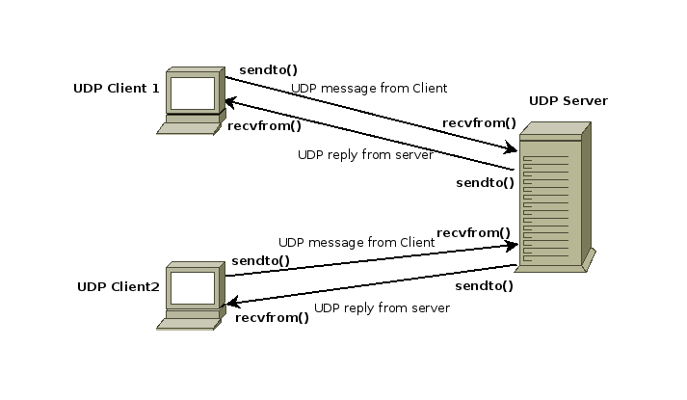

Slide 51
Properties of UDP:
The UDP does not provide guaranteed delivery of message packets. If for some issue in a network if a packet is lost it could be lost forever.
Since there is no guarantee of assured delivery of messages, UDP is considered an unreliable protocol.
The underlying mechanisms that implement UDP involve no connection-based communication. There is no streaming of data between a UDP server or and an UDP Client.
An UDP client can send "n" number of distinct packets to an UDP server and it could also receive "n" number of distinct packets as replies from the UDP server.
Since UDP is connectionless protocol the overhead involved in UDP is less compared to a connection based protocol like TCP.

Slide 52
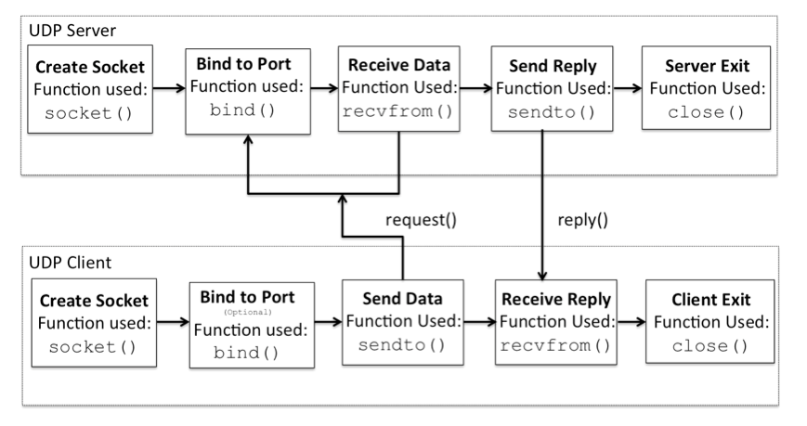

Slide 53
Udp Server Program
import socket
localIP = "127.0.0.1"
localPort = 20001
bufferSize = 1024
msgFromServer = "Hello UDP Client"
bytesToSend = str.encode(msgFromServer)
# Create a datagram socket
UDPServerSocket = socket.socket(family=socket.AF_INET, type=socket.SOCK_DGRAM)
# Bind to address and ip
UDPServerSocket.bind((localIP, localPort))
print("UDP server up and listening“)

Slide 54
while(True):
bytesAddressPair = UDPServerSocket.recvfrom(bufferSize)
message = bytesAddressPair[0]
address = bytesAddressPair[1]
clientMsg = "Message from Client:{}".format(message)
clientIP = "Client IP Address:{}".format(address)
print(clientMsg)
print(clientIP)
# Sending a reply to client
UDPServerSocket.sendto(bytesToSend, address)

Slide 55
Udp Client Program
import socket
msgFromClient = "Hello UDP Server"
bytesToSend = str.encode(msgFromClient)
serverAddressPort = ("127.0.0.1", 20001)
bufferSize = 1024
# Create a UDP socket at client side
UDPClientSocket = socket.socket(family=socket.AF_INET, type=socket.SOCK_DGRAM)

Slide 56
# Send to server using created UDP socket
UDPClientSocket.sendto(bytesToSend, serverAddressPort)
msgFromServer = UDPClientSocket.recvfrom(bufferSize)
msg = "Message from Server {}".format(msgFromServer[0])
print(msg)

Slide 57
What is a File server?
A file server is a computer responsible for the storage and management of data files so that other computers on the same network can access the files. It enables users to share information over a network without having to physically transfer files.
The file server takes on the computer or server role to store and make available data blobs (binary large object)to clients, serving as a central location to store and share files for a network. They can be limited to a single local area network (LAN) or can be open to the internet.

Slide 58
File server program
import socket # Import socket module
port = 60000 # Reserve a port for your service.
s = socket.socket() # Create a socket object
host = socket.gethostname() # Get local machine name
#host='0.0.0.0'
s.bind((host, port)) # Bind to the port
s.listen(5) # Now wait for client connection.
print ('Server listening....')
while True:
conn, addr = s.accept() # Establish connection with client.
print ('Got connection from', addr)
data = conn.recv(1024)
print('Server received', repr(data))

Slide 59
filename='mytext.txt'
f = open(filename,'rb')
l = f.read(1024)
while (l):
conn.send(l)
print('Sent ',repr(l))
l = f.read(1024)
f.close()
print('Done sending')
conn.send('Thank you for connecting')
conn.close()

Slide 60
File Client Program
import socket # Import socket module
s = socket.socket() # Create a socket object
host = socket.gethostname() # Get local machine name
IP = socket.gethostbyname(host)
port = 60000 # Reserve a port for your service.
print(IP)
s.connect((IP, port))
s.send(b"Hello server!")
with open('received_file', 'wb') as f:
print ('file opened')

Slide 61
while True:
print('receiving data...')
data = s.recv(1024)
print('data=%s', (data))
if not data:
break
# write data to a file
f.write(data)
f.close()
print('Successfully get the file')
s.close()
print('connection closed')

Slide 62
Output of Server program
Server listening....
Got connection from ('192.168.10.71', 59215)
Server received b'Hello server!'
Sent b"multithread tcp file transfer on localhost\r\nOur server code above can only interact with one client. If we try to connect with a second client, however, it simply won't reply to the new client. To let the server interact with multiple clients, we need to use multi-threading. Here is the new server script to accept multiple client connections:\r\n"
Done sending

Slide 63
Output of Client Program
192.168.10.71
file opened
receiving data...
data=%s b"multithread tcp file transfer on localhost\r\nOur server code above can only interact with one client. If we try to connect with a second client, however, it simply won't reply to the new client. To let the server interact with multiple clients, we need to use multi-threading. Here is the new server script to accept multiple client connections:\r\n"
receiving data...

Slide 64
Two way communication between Client and Server
It is possible to send data from the server and receive a response from the client. Similarly, the client can also send and receive data to-and-from.

Slide 65
Server program
import socket
def server_program():
# get the hostname
host = socket.gethostname()
port = 5000 # initiate port no above 1024
server_socket = socket.socket() # get instance
# look closely. The bind() function takes tuple as argument
server_socket.bind((host, port))
# bind host address and port together

Slide 66
# configure how many client the server can listen simultaneously
server_socket.listen(2)
conn, address = server_socket.accept() # accept new connection
print("Connection from: " + str(address))
while True:
# receive data stream. it won't accept data packet greater than 1024 bytes
data = conn.recv(1024).decode()
if not data:
# if data is not received break
break
print("from connected user: " + str(data))
data = input(' -> ')
conn.send(data.encode()) # send data to the client
conn.close() # close the connection
if __name__ == '__main__':
server_program()

Slide 67
Client Program
import socket
def client_program():
host = socket.gethostname()
# as both code is running on same pc
port = 5000 # socket server port number
client_socket = socket.socket() # instantiate
client_socket.connect((host, port)) # connect to the server
message = input(" -> ") # take input

Slide 68
while message.lower().strip() != 'bye':
client_socket.send(message.encode()) # send message
data = client_socket.recv(1024).decode() # receive response
print('Received from server: ' + data) # show in terminal
message = input(" -> ") # again take input
client_socket.close() # close the connection
if __name__ == '__main__':
client_program()

Slide 69
Sending Email using SMTP
Python has a library called smtplib which is used to send emails. The library smtplib is based on the SMTP (Simple Mail Transport Protocol). SMTP is used to send emails to others.
Setup Gmail
Here, we are going to use Gmail as an email provider. Google doesn’t allow scripts to sign in. And we need to make a change in the security of our Gmail account that allows scripts to sign in to our Gmail account.
Changing the security option in our Gmail account is not good as it allows others to access the account very easily. It’s recommended to create a new Gmail account. Go to the settings here and turn on the Allow less secure apps: ON setting.

Slide 70
Steps to Send Mail
Certain steps need to be done to send a mail using the smtplib library. Let’s see the steps first and then we’ll write the script.
#1. Connecting to the SMTP server
Each service provider will have a different SMTP server domain name and port. We have to use the SMTP server domain name and port of email provider that we are going to use in the script. The SMTP server domain name and port for Gmail are smtp.gmail.com and <em>465</em>.
We will be using SSL encryption for the SMTP server connection as it is more secure than the TSL encryption. If you want to use the TSL encryption, then use the port 587 instead of 465. The SMTP server domain name will be different based on the email service provider.

Slide 71
The code to connect to the SMTP server
server = smtplib.SMTP_SSL(smtp_server_domain_name, port, context=ssl_context)
#2. Login
Once the connection is established to the SMTP server, we can log in using the email address and password with the login SMTP object’s method. The code looks as follows.
server.login(sender_email, password)
#3. Send Mail
After login, there is no way we can wait to send the mail. Send the mail using sendmail the method. Make sure you send the mail in the following format.
Subject: your_subject_for \newline mail_content

Slide 72
Spaces are not necessary. They are just for clarification in the above format. Let’s see the sample code.
server.sendmail(sender_mail, email, f"Subject: {subject}\n{content}")
#4. Quit
Don’t forget to quit the SMTP

Slide 73
Program for sending email (email3.py)
import smtplib, ssl
class Mail:
def __init__(self):
self.port = 465
self.smtp_server_domain_name = "smtp.gmail.com"
self.sender_mail = "sendermail@gmail.com"
self.password = "senderpassword"
def send(self, emails, subject, content):
ssl_context = ssl.create_default_context()
service = smtplib.SMTP_SSL(self.smtp_server_domain_name, self.port, context=ssl_context)
service.login(self.sender_mail, self.password)

Slide 74
for email in emails:
result = service.sendmail(self.sender_mail, email, f"Subject: {subject}\n{content}")
service.quit()
if __name__ == '__main__':
mails = input("Enter emails: ").split()
subject = input("Enter subject: ")
content = input("Enter content: ")
mail = Mail()
mail.send(mails, subject, content)

Slide 75
Event-Driven Programming

Slide 76
When a program runs in Python the Python interpreter scans the program from top to bottom executing the first statement that is not part of a function definition. The program proceeds by executing the next statement and the next. Sequential execution is redirected by iteration (i.e. for and while loops) and function calls. Nevertheless, the program sequentially executes until Python interprets the last statement at which point the program terminates.

Slide 77
In an event-driven program sequential execution is in response to events happening while the program is executing. Event-driven programs arise in many areas of programming including Operating Systems, Internet Programming, Distributed Computing, and Graphical User Interfaces, often abbreviated GUI programs. An event-driven application begins as a sequential program executing one statement after another until it enters a never-ending loop. This loop, sometimes called the event dispatch loop looks for an incoming event and then dispatches that event to an event handler.

Slide 78
Events come in a wide variety of flavors including:
• An interrupt indicating the completion of a disk operation
• A network packet has become available
• A network connection has become unavailable
• A button was pressed in a GUI application
• A menu item was selected in a GUI application
• An incoming request has been received by a web server.

Slide 79
Tk is a powerful Application Programming Interface, or API, designed to make GUI programming easy on a variety of operating systems including Mac OS X, Windows, and Linux . An API is a set of classes, or types, and functions that can be useful when implementing a program. In the case of Python, the Tkinter API was designed to allow Python programs to work with the Tk package to implement GUI programs that will run on Windows, Mac OS X, or Linux. The Tkinter API is included in a module called tkinter. The module is included with most distributions of Python and may be imported to use in your Python programs.

Slide 80
Tk programs use widgets to build a GUI application. The term widget has been used at least since the 1980s to refer to any element of a GUI application including windows, buttons, menus, text entry fields, frames, listboxes, etc. There are many different widgets available in tkinter. Typically, any element you can see (and some you can't see, like frames) in a GUI application is a widget.

Slide 81
GUI using Tkinter:
Most of you write a code and run it in a command-line terminal or an IDE (Integrated Development Environment), and the code produces an output based on what you expect out of it either on the terminal or on the IDE itself. However, what if you want your system to have a fancy looking user-interface or maybe your application (use-case) requires you to have a GUI.
GUI is nothing but a desktop app that provides you with an interface that helps you to interact with the computers and enriches your experience of giving a command (command-line input) to your code. They are used to perform different tasks in desktops, laptops, and other electronic devices, etc.

Slide 82
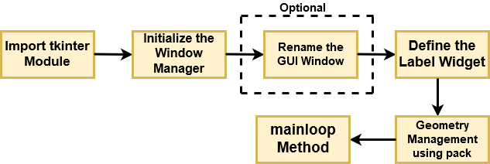
Tkinter commonly comes bundled with Python, using Tk and is Python's standard GUI framework. It is famous for its simplicity and graphical user interface. It is open-source and available under the Python License.
Flow Diagram for Rendering a Basic GUI

Slide 83
Let's break down the above flow diagram and understand what each component is handling!
First, you import the key component, i.e., the Tkinter module.
As a next step, you initialize the window manager with the tkinter.Tk() method and assign it to a variable. This method creates a blank window with close, maximize, and minimize buttons on the top as a usual GUI should have.
Then as an optional step, you will Rename the title of the window as you like with window.title(title_of_the_window).
Next, you make use of a widget called Label, which is used to insert some text into the window.
Then, you make use of Tkinter's geometry management attribute called pack() to display the widget in size it requires.
Finally, as the last step, you use the mainloop() method to display the window until you manually close it. It runs an infinite loop in the backend.

Slide 84

import tkinter
window = tkinter.Tk()
# to rename the title of the window
window.title("GUI")
# pack is used to show the object in the window
label = tkinter.Label(window, text = "Welcome to DataCamp's Tutorial on Tkinter!").pack()
window.mainloop()
Output :

Slide 85
Widgets
Widgets are similar in spirit to elements in HTML. You will find different types of widgets for different types of elements in the Tkinter. They are standard GUI elements and provide the user with controls like buttons, text, menus, and text boxes.
Let's understand all of these widgets in Tkinter, along with an example
Button: Button widget has a property for switching on/off. When a user clicks the button, an event is triggered in the Tkinter.
Syntax:
button_widget = tk.Button(widget,option=placeholder)
where widget is the argument for the parent window/frame while option is a placeholder that can have various values like foreground & background color, font, command (for function call), image, height, and width of button.

Slide 86
Canvas: Canvas is used to draw shapes in your GUI and supports various drawing methods.
Syntax:
canvas_widget = tk.Canvas(widget, option=placeholder)
where widget is the parameter for the parent window/frame while option is a placeholder that can have various values like border-width, background color, height and width of widget.

Slide 87
Entry: Entry widget is used to create input fields or to get input text from the user within the GUI.
Syntax:
entry_widget = tk.Entry(widget, option=placeholder)
where widget is the parameter for the parent window/frame while option is a placeholder that can have various values like border-width, background color, width & height of button etc.

Slide 88
Frame: Frame is used as containers in the Tkinter for grouping and adequately organizing the widgets.
Syntax:
frame_widget = tk.Frame(widget, option=placeholder)
where widget is the parameter for the parent window/frame while option is a placeholder that can have various values like border-width, height & width of widget, highlightcolor (color when widget has to be focused).

Slide 89
Label: Label is used to create a single line widgets like text, images, etc.
Syntax:
label_widget = tk.Label(widget, option=placeholder)
where widget is the parameter for the parent window/frame while option is a placeholder that can have various values like the font of a button, background color, image, width, and height of button.

Slide 90
Geometry Management
All widgets in Tkinter have some geometry measurements. These geometry measurements allow you to organize the widgets and throughout the parent frames or parent widget area.
One of the geometry management classes, i.e., pack(), has already been covered here.
For this purpose, Tkinter provides you with three main geometry manager classes:
pack(): It organizes the widgets in a block manner, and the complete available width is occupied by it. It's a conventional method to show the widgets in the window.
grid(): It organizes the widgets in a table-like structure.
place(): Its purpose is to place the widgets at a specific position as instructed by the user in the parent widget.

Slide 91
import tkinter
window = tkinter.Tk()
window.title("Button GUI")
button_widget = tkinter.Button(window,text="Welcome to Tutorial on Tkinter")
button_widget.pack()
tkinter.mainloop()

Slide 92
Python Tkinter pack() method
The pack() widget is used to organize widget in the block. The positions widgets added to the python application using the pack() method can be controlled by using the various options specified in the method call.
However, the controls are less and widgets are generally added in the less organized manner.
The syntax to use the pack() is given below.
syntax
widget.pack(options)
A list of possible options that can be passed in pack() is given below.
expand: If the expand is set to true, the widget expands to fill any space.
Fill: By default, the fill is set to NONE. However, we can set it to X or Y to determine whether the widget contains any extra space.
size: it represents the side of the parent to which the widget is to be placed on the window.

Slide 93
Example
# !/usr/bin/python3
from tkinter import *
parent = Tk()
redbutton = Button(parent, text = "Red", fg = "red")
redbutton.pack( side = LEFT)
greenbutton = Button(parent, text = "Black", fg = "black")
greenbutton.pack( side = RIGHT )
bluebutton = Button(parent, text = "Blue", fg = "blue")
bluebutton.pack( side = TOP )
blackbutton = Button(parent, text = "Green", fg = "red")
blackbutton.pack( side = BOTTOM)
parent.mainloop()

Slide 94

Output :

Slide 95
Tkinter grid() method
The grid() geometry manager organizes the widgets in the tabular form. We can specify the rows and columns as the options in the method call. We can also specify the column span (width) or rowspan(height) of a widget.
This is a more organized way to place the widgets to the python application. The syntax to use the grid() is given below.
Syntax
widget.grid(options)

Slide 96
A list of possible options that can be passed inside the grid() method is given below.
Column The column number in which the widget is to be placed. The leftmost column is represented by 0.
Columnspan The width of the widget. It represents the number of columns up to which, the column is expanded.
ipadx, ipady It represents the number of pixels to pad the widget inside the widget's border.
padx, pady It represents the number of pixels to pad the widget outside the widget's border.
row The row number in which the widget is to be placed. The topmost row is represented by 0.
rowspan The height of the widget, i.e. the number of the row up to which the widget is expanded.
Sticky If the cell is larger than a widget, then sticky is used to specify the position of the widget inside the cell. It may be the concatenation of the sticky letters representing the position of the widget. It may be N, E, W, S, NE, NW, NS, EW, ES.

Slide 97
Example
# !/usr/bin/python3
from tkinter import *
parent = Tk()
name = Label(parent,text = "Name").grid(row = 0, column = 0)
e1 = Entry(parent).grid(row = 0, column = 1)
password = Label(parent,text = "Password").grid(row = 1, column = 0)
e2 = Entry(parent).grid(row = 1, column = 1)
submit = Button(parent, text = "Submit").grid(row = 4, column = 0)
parent.mainloop()

Slide 98
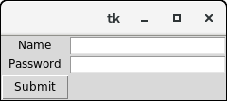
Output :

Slide 99
Tkinter place() method
The place() geometry manager organizes the widgets to the specific x and y coordinates.
Syntax
widget.place(options)
A list of possible options is given below.
Anchor: It represents the exact position of the widget within the container. The default value (direction) is NW (the upper left corner)
bordermode: The default value of the border type is INSIDE that refers to ignore the parent's inside the border. The other option is OUTSIDE.
height, width: It refers to the height and width in pixels.
relheight, relwidth: It is represented as the float between 0.0 and 1.0 indicating the fraction of the parent's height and width.
relx, rely: It is represented as the float between 0.0 and 1.0 that is the offset in the horizontal and vertical direction.
x, y: It refers to the horizontal and vertical offset in the pixels.

Slide 100
Example
# !/usr/bin/python3
from tkinter import *
top = Tk()
top.geometry("400x250")
name = Label(top, text = "Name").place(x = 30,y = 50)
email = Label(top, text = "Email").place(x = 30, y = 90)
password = Label(top, text = "Password").place(x = 30, y = 130)
e1 = Entry(top).place(x = 80, y = 50)
e2 = Entry(top).place(x = 80, y = 90)
e3 = Entry(top).place(x = 95, y = 130)
top.mainloop()

Slide 101
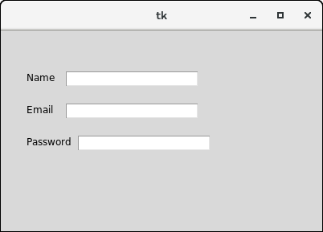
Output :

Slide 102
Displaying Text and Images With Label Widgets
Label widgets are used to display text or images. The text displayed by a Label widget can’t be edited by the user. It’s for display purposes only. you can create a Label widget by instantiating the Label class and passing a string to the text parameter:
label = tk.Label(text="Hello, Tkinter")
You can control Label text and background colors using the foreground and background parameters:
label = tk.Label( text="Hello, Tkinter",
foreground="white", # Set the text color to white background="black" # Set the background color to black )
There are numerous valid color names, including:
"red“ "orange“ "yellow“ "green“ "blue"
"purple”

Slide 103
You can also specify a color using hexadecimal RGB values:
label = tk.Label(text="Hello, Tkinter", background="#34A2FE")
If you don’t feel like typing out foreground and background all the time, then you can use the shorthand fg and bg parameters to set the foreground and background colors:
label = tk.Label(text="Hello, Tkinter", fg="white", bg="black")
Example:
import tkinter as tk
label = tk.Label(
text="Hello, Tkinter",
fg="white",
bg="black",
width=10,
height=10
)
label.pack()

Slide 104
Displaying Clickable Buttons With Button Widgets
Button widgets are used to display clickable buttons. They can be configured to call a function whenever they’re clicked.
There are many similarities between Button and Label widgets. In many ways, a Button is just a Label that you can click! The same keyword arguments you use to create and style a Label will work with Button widgets. For example, the following code creates a Button with a blue background and yellow text. It also sets the width and height to 25 and 5 text units, respectively:

Slide 105
Import tkinter as tk
button = tk.Button( text="Click me!",
width=25, height=5,
bg="blue", fg="yellow", )
Button.pack()

Slide 106
Getting User Input With Entry Widgets
When you need to get a little bit of text from a user, like a name or an email address, use an Entry widget. They display a small text box that the user can type some text into.
entry = tk.Entry(fg="yellow", bg="blue", width=50)
The interesting bit about Entry widgets isn’t how to style them, though. It’s how to use them to get input from a user. There are three main operations that you can perform with Entry widgets:
Retrieving text with .get()
Deleting text with .delete()
Inserting text with .insert()

Slide 107
Building a Temperature Converter (Example App)
You need three elements:
An Entry widget called ent_temperature to enter the Fahrenheit value
A Label widget called lbl_result to display the Celsius result
A Button widget called btn_convert that reads the value from the Entry widget, converts it from Fahrenheit to Celsius, and sets the text of the Label widget to the result when clicked

Slide 108
Example
import tkinter as tk
def fahrenheit_to_celsius():
"""Convert the value for Fahrenheit to Celsius and insert the
result into lbl_result.
"""
fahrenheit = ent_temperature.get()
celsius = (5/9) * (float(fahrenheit) - 32)
lbl_result["text"] = f"{round(celsius, 2)} \N{DEGREE CELSIUS}"
window = tk.Tk()
window.title("Temperature Converter")
frm_entry = tk.Frame(master=window)
ent_temperature = tk.Entry(master=frm_entry, width=10)
lbl_temp = tk.Label(master=frm_entry, text="\N{DEGREE FAHRENHEIT}")

Slide 109
ent_temperature.grid(row=0, column=0, sticky="e")
lbl_temp.grid(row=0, column=1, sticky="w")
btn_convert = tk.Button(
master=window,
text="\N{RIGHTWARDS BLACK ARROW}",
command=fahrenheit_to_celsius # <--- Add this line
)
lbl_result = tk.Label(master=window, text="\N{DEGREE CELSIUS}")
frm_entry.grid(row=0, column=0, padx=10)
btn_convert.grid(row=0, column=1, pady=10)
lbl_result.grid(row=0, column=2, padx=10)
window.mainloop()

Slide 110
Dialogs
Tkinter (and TK of course) provides a set of dialogues (dialogs in American English spelling), which can be used to display message boxes, showing warning or errors, or widgets to select files and colours. There are also simple dialogues, asking the user to enter string, integers or float numbers.
import tkinter as tk
from tkinter import messagebox as mb
def answer():
mb.showerror("Answer", "Sorry, no answer available")
def callback():
if mb.askyesno('Verify', 'Really quit?'):
mb.showwarning('Yes', 'Not yet implemented')
else:
mb.showinfo('No', 'Quit has been cancelled‘)
tk.Button(text='Quit', command=callback).pack(fill=tk.X)
tk.Button(text='Answer', command=answer).pack(fill=tk.X)
tk.mainloop()

Slide 111
Standard Dialog Boxes
Messages
A messagebox can display information to a user. There are three variations on these dialog boxes based on the type of message you want to display. The functions’ first parameter gives a name for the dialog box which is displayed in the window’s header. The second parameter is the text of the message. The functions return a string which is typically ignored.
from tkinter import messagebox messagebox.showinfo("Information","Informative message") messagebox.showerror("Error", "Error message") messagebox.showwarning("Warning","Warning message")

Slide 112
Yes/No Questions
The tkinter messagebox object also allows you to ask a user simple yes/no type questions and varies the button names based on the type of question. These functions are:
from tkinter import messagebox
answer = messagebox.askokcancel("Question","Do you want to open this file?")
answer = messagebox.askretrycancel("Question", "Do you want to try that again?")
answer = messagebox.askyesno("Question","Do you like Python?")
answer = messagebox.askyesnocancel("Question", "Continue playing?")
The return value is a Boolean, True or False, answer to the question. If “cancel” is an option and the user selects the “cancel” button, None is returned.

Slide 113
Single Value Data Entry
If you want to ask the user for a single data value, either a string, integer, or floating point value, you can use a simpledialog object. A user can enter the requested value and hit “OK”, which will return the entered value. If the user hits “Cancel,” then None is returned.
import tkinter as tk from tkinter import simpledialog application_window = tk.Tk()
answer = simpledialog.askstring("Input", "What is your first name?", parent=application_window)
if answer is not None:
("Your first name is ", answer)
else:
("You don't have a first name?")

Slide 114
answer = simpledialog.askinteger("Input", "What is your age?", parent=application_window, minvalue=0, maxvalue=100)
if answer is not None:
("Your age is ", answer)
else:
("You don't have an age?")
answer = simpledialog.askfloat("Input", "What is your salary?", parent=application_window, minvalue=0.0, maxvalue=100000.0)
if answer is not None:
("Your salary is ", answer)
else:
("You don't have a salary?")

Slide 115
File Chooser
A common task is to select the names of folders and files on a storage device. This can be accomplished using a filedialog object. Note that these commands do not save or load a file. They simply allow a user to select a file. Once you have the file name, you can open, process, and close the file using appropriate Python code. These dialog boxes always return you a “fully qualified file name” that includes a full path to the file. Also note that if a user is allowed to select multiple files, the return value is a tuple that contains all of the selected files. If a user cancels the dialog box, the returned value is an empty string.

Slide 116
import tkinter as tk
from tkinter import filedialog
import os
application_window = tk.Tk()
# Build a list of tuples for each file type the file dialog should display
my_filetypes = [('all files', '.*'), ('text files', '.txt')]
# Ask the user to select a folder.
answer = filedialog.askdirectory(parent=application_window, initialdir=os.getcwd(), title="Please select a folder:")

Slide 117
# Ask the user to select a single file name.
answer = filedialog.askopenfilename(parent=application_window, initialdir=os.getcwd(), title="Please select a file:", filetypes=my_filetypes)
# Ask the user to select a one or more file names.
answer = filedialog.askopenfilenames(parent=application_window, initialdir=os.getcwd(),
title="Please select one or more files:", filetypes=my_filetypes)
# Ask the user to select a single file name for saving.
answer = filedialog.asksaveasfilename(parent=application_window, initialdir=os.getcwd(),
title="Please select a file name for saving:", filetypes=my_filetypes)

Slide 118
Color Chooser
Tkinter includes a nice dialog box for choosing colors. You provide it with a parent window and an initial color, and it returns a color in two different specifications: 1) a RGB value as a tuple, such as (255, 0, 0) which represents red, and 2) a hexadecimal string used in web pages, such as "#FF0000" which also represents red. If the user cancels the operation, the return values are None and None.
from tkinter import colorchooser
rgb_color, web_color = colorchooser.askcolor(parent=application_window, initialcolor=(255, 0, 0))

Slide 119
Open File Dialogue
Tkinter provides the module tkFileDialog for these purposes.
import tkinter as tk
from tkinter import filedialog as fd
def callback():
name= fd.askopenfilename()
print(name)
errmsg = 'Error!'
tk.Button(text='File Open',
command=callback).pack(fill=tk.X)
tk.mainloop()

Slide 120
Assigning Widgets to Frames With Frame Widgets
Frame widgets are important for organizing the layout of your widgets in an application.
Before you get into the details about laying out the visual presentation of your widgets, take a closer look at how Frame widgets work, and how you can assign other widgets to them. The following script creates a blank Frame widget and assigns it to the main application window:
import tkinter as tk
window = tk.Tk()
frame = tk.Frame()
frame.pack()
window.mainloop()

Slide 121

frame.pack() packs the frame into the window so that the window sizes itself as small as possible to encompass the frame. When you run the above script, you get some seriously uninteresting output:
An empty Frame widget is practically invisible. Frames are best thought of as containers for other widgets. You can assign a widget to a frame by setting the widget’s master attribute:
frame = tk.Frame()
label = tk.Label(master=frame)

Slide 122
write a script that creates two Frame widgets called frame_a and frame_b. In this script, frame_a contains a label with the text "I'm in Frame A", and frame_b contains the label "I'm in Frame B". Here’s one way to do this:

Slide 123
import tkinter as tk
window = tk.Tk()
frame_a = tk.Frame()
frame_b = tk.Frame()
label_a = tk.Label(master=frame_a, text="I'm in Frame A")
label_a.pack()
label_b = tk.Label(master=frame_b, text="I'm in Frame B")
label_b.pack()
frame_a.pack()
frame_b.pack()
window.mainloop()

Slide 124

Note that frame_a is packed into the window before frame_b. The window that opens shows the label in frame_a above the label in frame_b:
Now see what happens when you swap the order of frame_a.pack() and frame_b.pack():

Slide 125
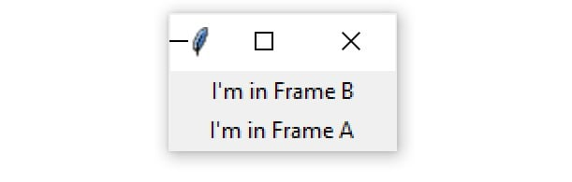
import tkinter as tk
window = tk.Tk()
frame_a = tk.Frame()
label_a = tk.Label(master=frame_a, text="I'm in Frame A")
label_a.pack() frame_b = tk.Frame()
label_b = tk.Label(master=frame_b, text="I'm in Frame B")
label_b.pack()
# Swap the order of `frame_a` and `frame_b` frame_b.pack() frame_a.pack() window.mainloop()
Now label_b is on top. Since label_b is assigned to frame_b, it moves to wherever frame_b is positioned.

Slide 126
Tkinter Frame :
The Frame widget is very important for the process of grouping and organizing other widgets in a somehow friendly way. It works like a container, which is responsible for arranging the position of other widgets.
It uses rectangular areas in the screen to organize the layout and to provide padding of these widgets. A frame can also be used as a foundation class to implement complex widgets.
Syntax
Here is the simple syntax to create this widget −
w = Frame ( master, option, ... ) Parameters
master − This represents the parent window.
options − Here is the list of most commonly used options for this widget. These options can be used as key-value pairs separated by commas.

Slide 127
Sr.No. | Option & Description
1 | bg The normal background color displayed behind the label and indicator.
2 | bd The size of the border around the indicator. Default is 2 pixels.
3 | cursor If you set this option to a cursor name (arrow, dot etc.), the mouse cursor will change to that pattern when it is over the checkbutton.
4 | height The vertical dimension of the new frame.
5 | highlightbackground Color of the focus highlight when the frame does not have focus.
6 | highlightcolor Color shown in the focus highlight when the frame has the focus.
7 | width The default width of a checkbutton is determined by the size of the displayed image or text. You can set this option to a number of characters and the checkbutton will always have room for that many characters.

Slide 128
# !/usr/bin/python3
from tkinter import *
root = Tk()
frame = Frame(root)
frame.pack()
bottomframe = Frame(root)
bottomframe.pack( side = BOTTOM )
redbutton = Button(frame, text = "Red", fg = "red")
redbutton.pack( side = LEFT)
greenbutton = Button(frame, text = "Brown", fg="brown") greenbutton.pack( side = LEFT )
bluebutton = Button(frame, text = "Blue", fg = "blue") bluebutton.pack( side = LEFT )
blackbutton = Button(bottomframe, text = "Black", fg = "black") blackbutton.pack( side = BOTTOM)
root.mainloop()

Slide 129

Output :

Slide 130
UNIT- 4 COMPLETED

